Slide 1
Let’s make a movie
Cadette Digital Movie-Maker Badge Workshop

Slide 2
What’s your favorite movie (or a movie you really like)?
When was it made?
What do you like about it?
How do you feel when you watch it?

Slide 3
Production Crew

Slide 4
Production Crew Roles
Director
Assistant Director (AD)
Director of Photography/
Sound Mixer
Boom Operator
Gaffer
Grip
And more… https://filmincolorado.com/resources/job-descriptions/

Slide 5
Cinematography

Slide 6
Shot Composition
Follow the “rule of thirds”
Imagine a 3 x 3 grid on your image, align subjects where those lines cross and intersect in the frame
Provides a balanced image, prevents a wandering eye from the viewer, helps to effectively convey important information
Everything in the frame should communicate something to the viewer

Slide 7
Rear Window (1954)
Directed by Alfred Hitchcock, Rear Window has great examples of excellent shot composition.
Notice the lead room for our main subject, and that the other character is on the bottom third.

Slide 8
Depth of Field
In photography and cinematography, depth of field is the distance between the nearest and the farthest objects that are in acceptably sharp focus in an image.
3 factors contribute to depth of field: aperture, focal length, focus distance.
Depth of field is used to describe the depth of focus within an image. An image with a shallow depth of field has the majority of the background out of focus, while a large depth of field has many details in the background in sharp focus.
Depth of field is a tool that can be used to convey or conceal information within a film by drawing attention towards some subjects and away from others. It can also be used as a stylistic choice as some directors are known for using one or the other.

Slide 9
Focal Length: Wide, normal, and telephoto lenses

Slide 10
Shallow Focus

Slide 11
Deep Focus
Captain Marvel (2019)

Slide 12
The 180 degree line or “line of action”

Slide 13
Shot Reverse Shot
A staple of editing in dialogue scenes
“This type of framing, when edited together, gives the audience a sense of continuous action, making it seem as though the scene they're watching is happening linearly in real time.”
Let’s look at an example…

Slide 14
The Hunger Games (2012)

Slide 15
Creative Uses of Shot Composition
They way you frame a subject can convey different information within a film
Creative uses of composition can create anxiety in the viewer, suggest dangerous/perilous situations, hint at important information within the story, etc.

Slide 16
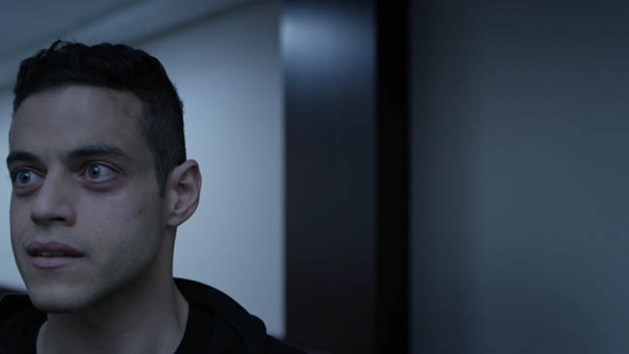

Slide 17
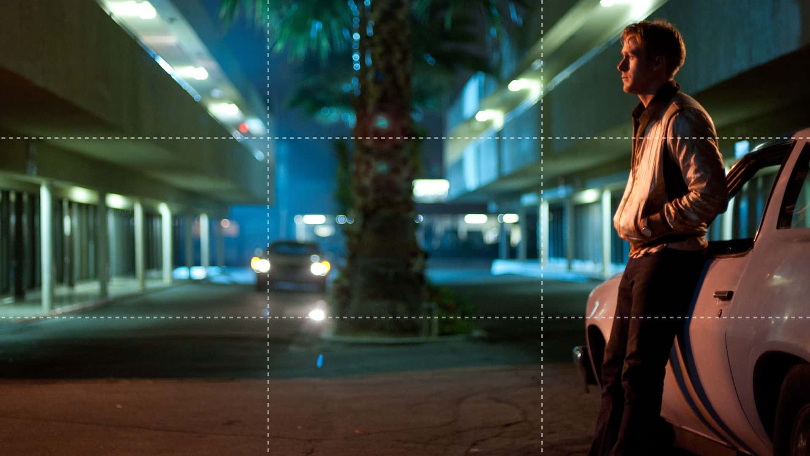

Slide 18
Shot Types
Extreme Close-Up (ECU)
Close-Up (CU)
Medium Close-Up (MCU)
Medium Shot (MS)
Medium Long Shot (MLS)
Long Shot (LS)
Wide shot and establishing shot
Insert

Slide 19
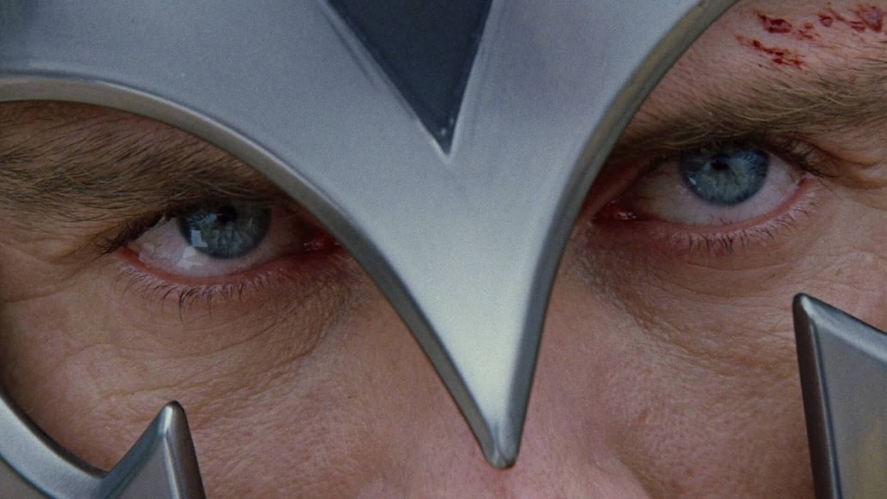

Slide 20
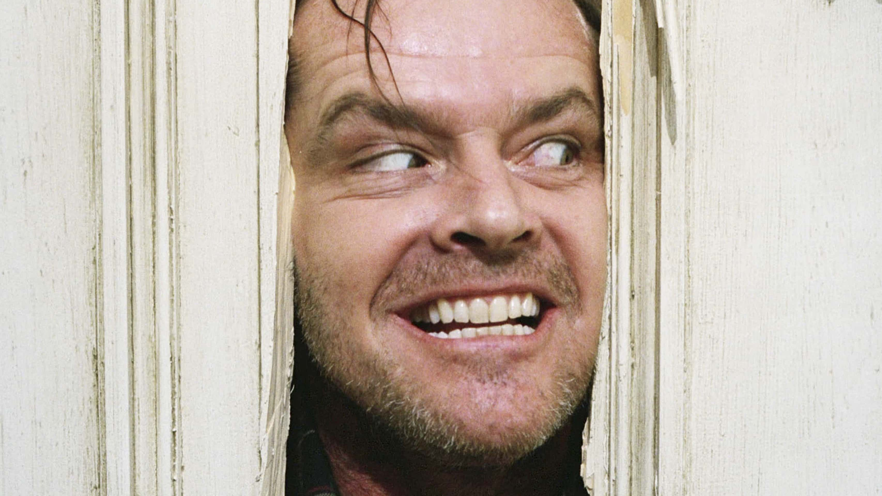

Slide 21
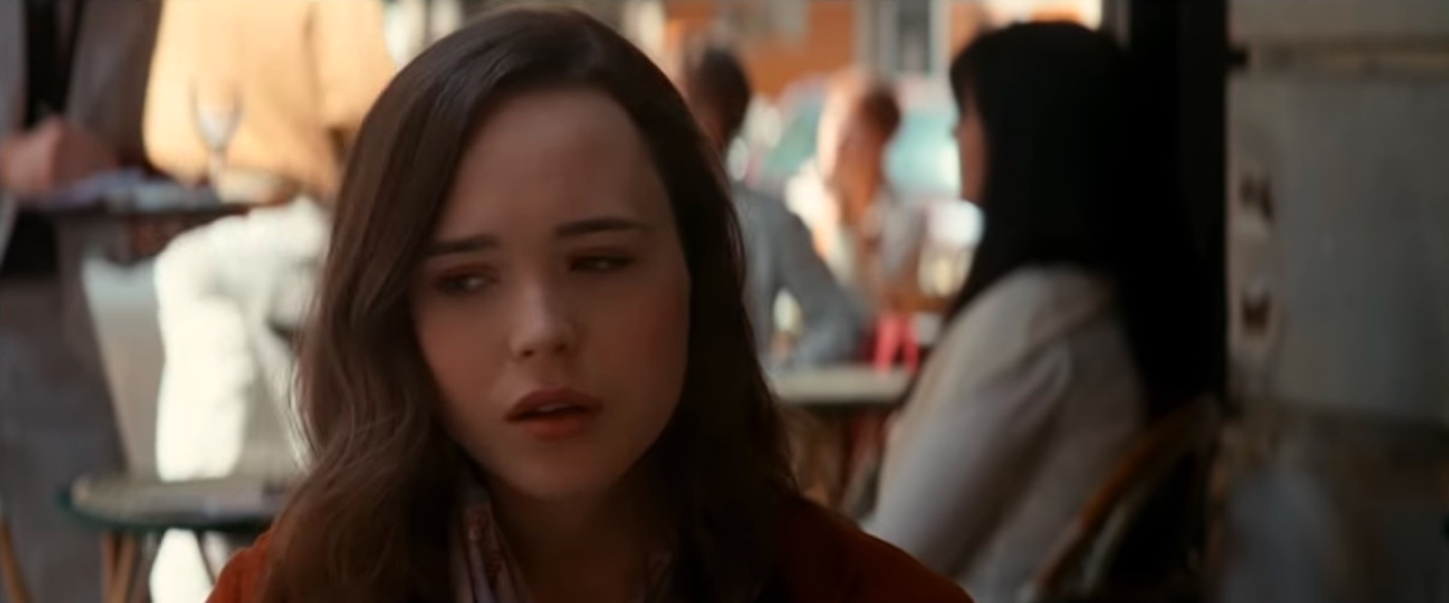

Slide 22
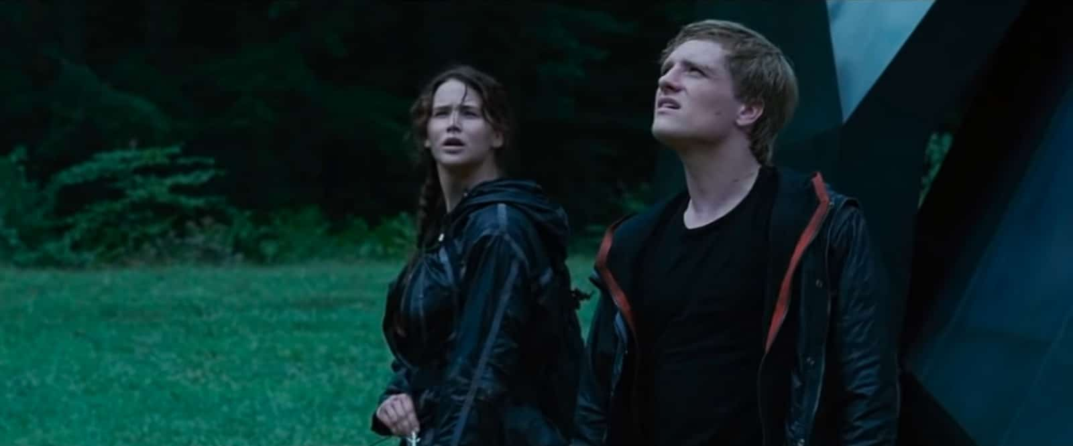

Slide 23
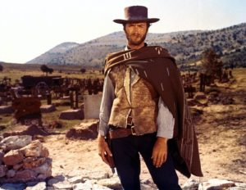

Slide 24
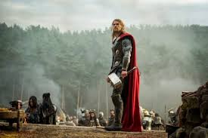

Slide 25
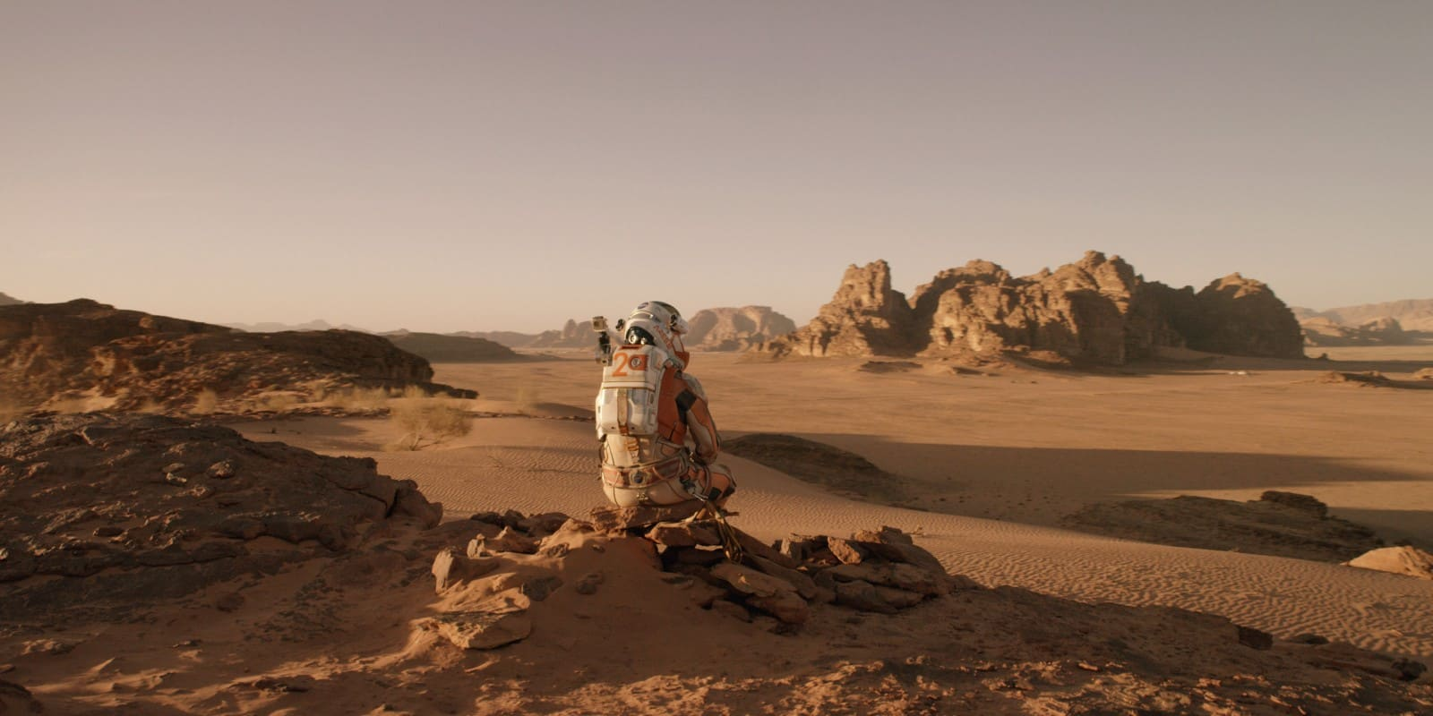

Slide 26
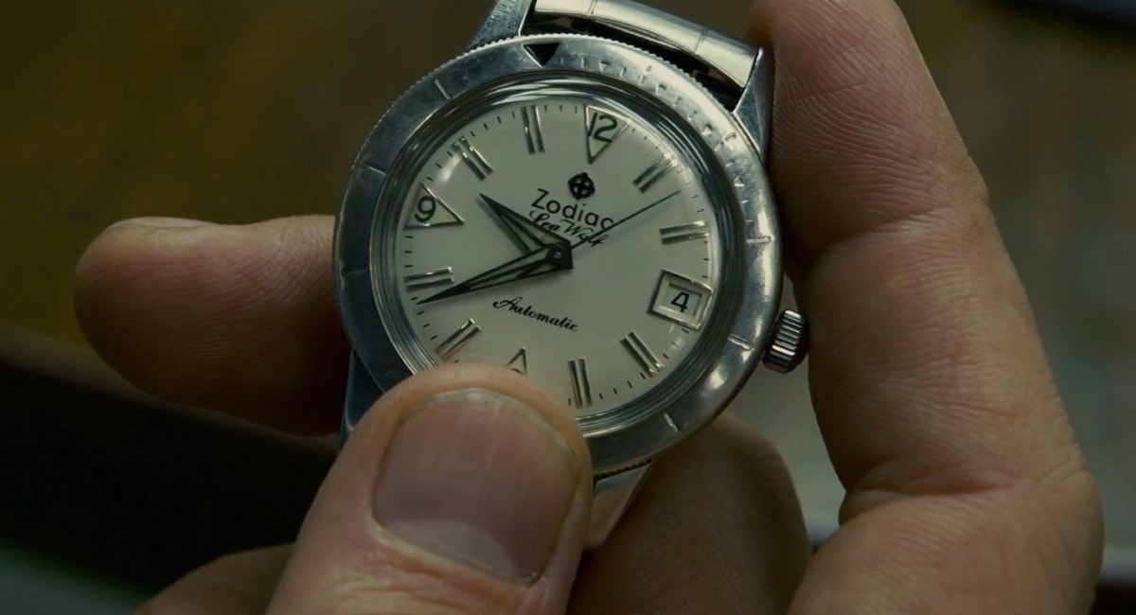

Slide 27
Camera Angle
Low angle
High angle
Canted angle
Eye level or neutral shot
POV

Slide 28
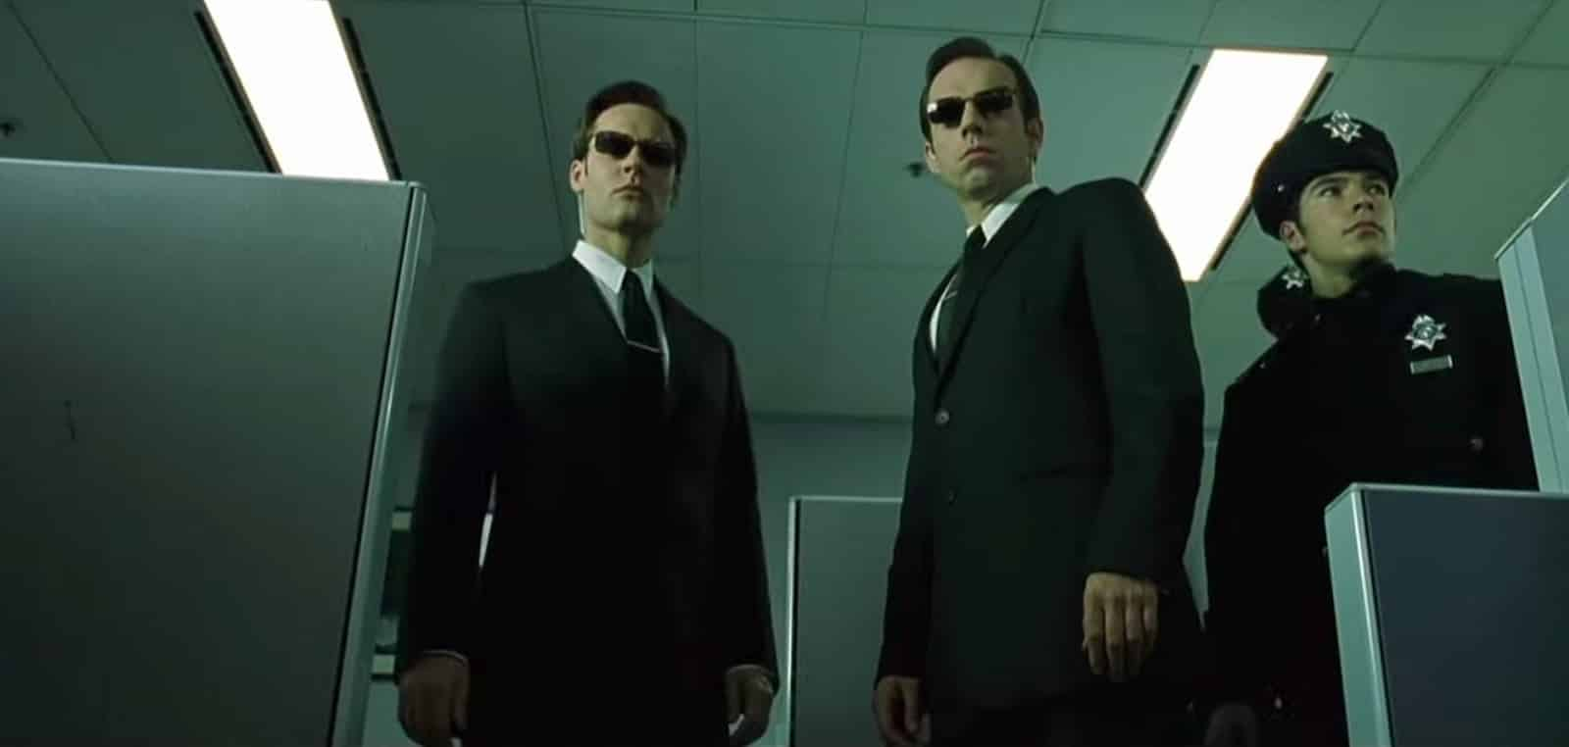

Slide 29
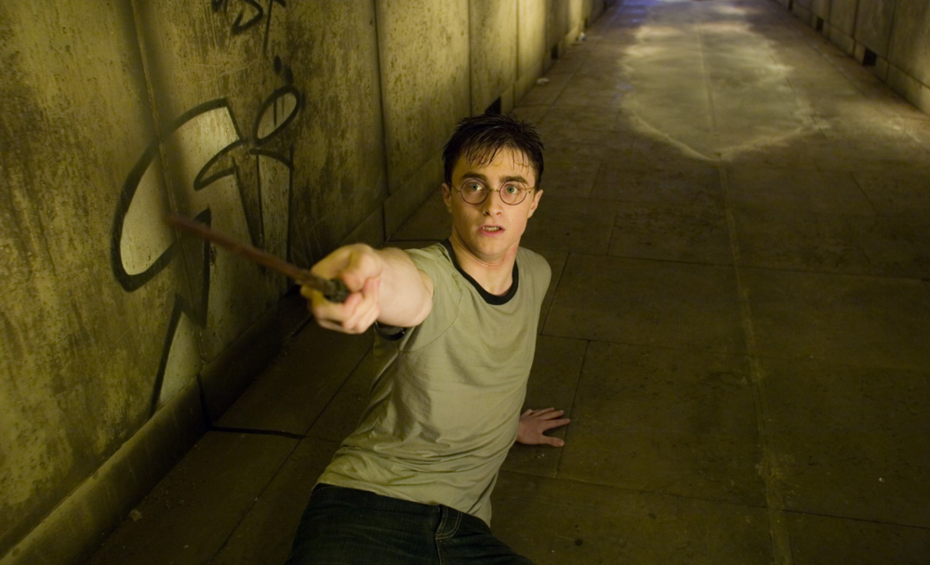

Slide 30
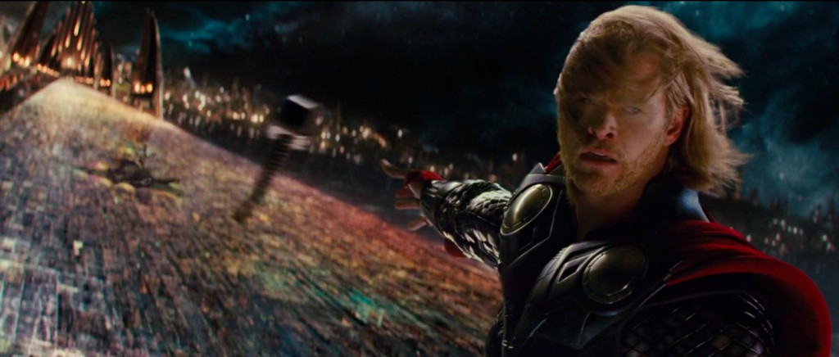

Slide 31
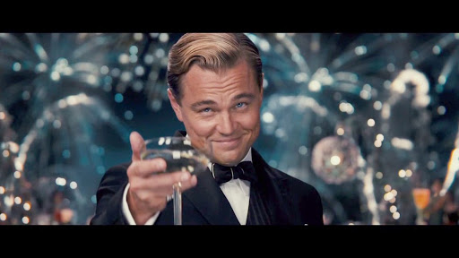

Slide 32
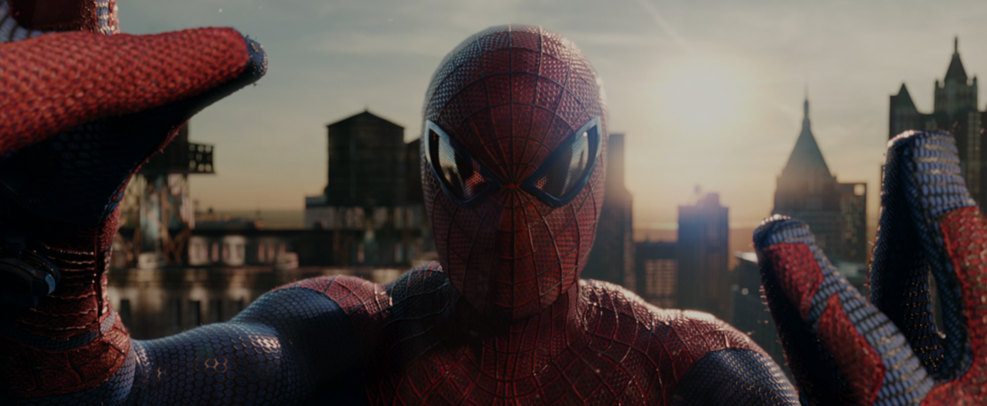

Slide 33
Camera Movement
Tilt
Pan
Dolly (in, out, etc.)
Rack focus

Slide 34
Storyboarding

Slide 35
Why Create a Storyboard?
Helps to map out story visually
Important for planning scenes in terms of camera and actor placement
Placement of actors, objects, etc. is known as “blocking”
Helpful in ordering scenes for editing
First step before creating the shot list and overhead diagrams

Slide 36
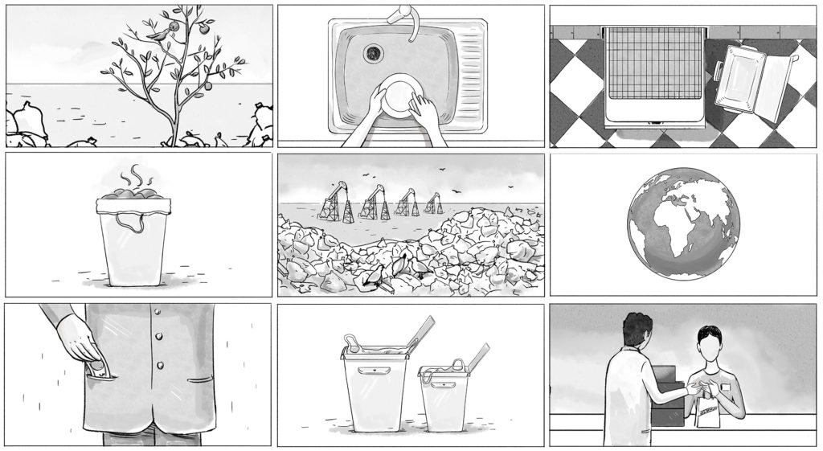

Slide 38
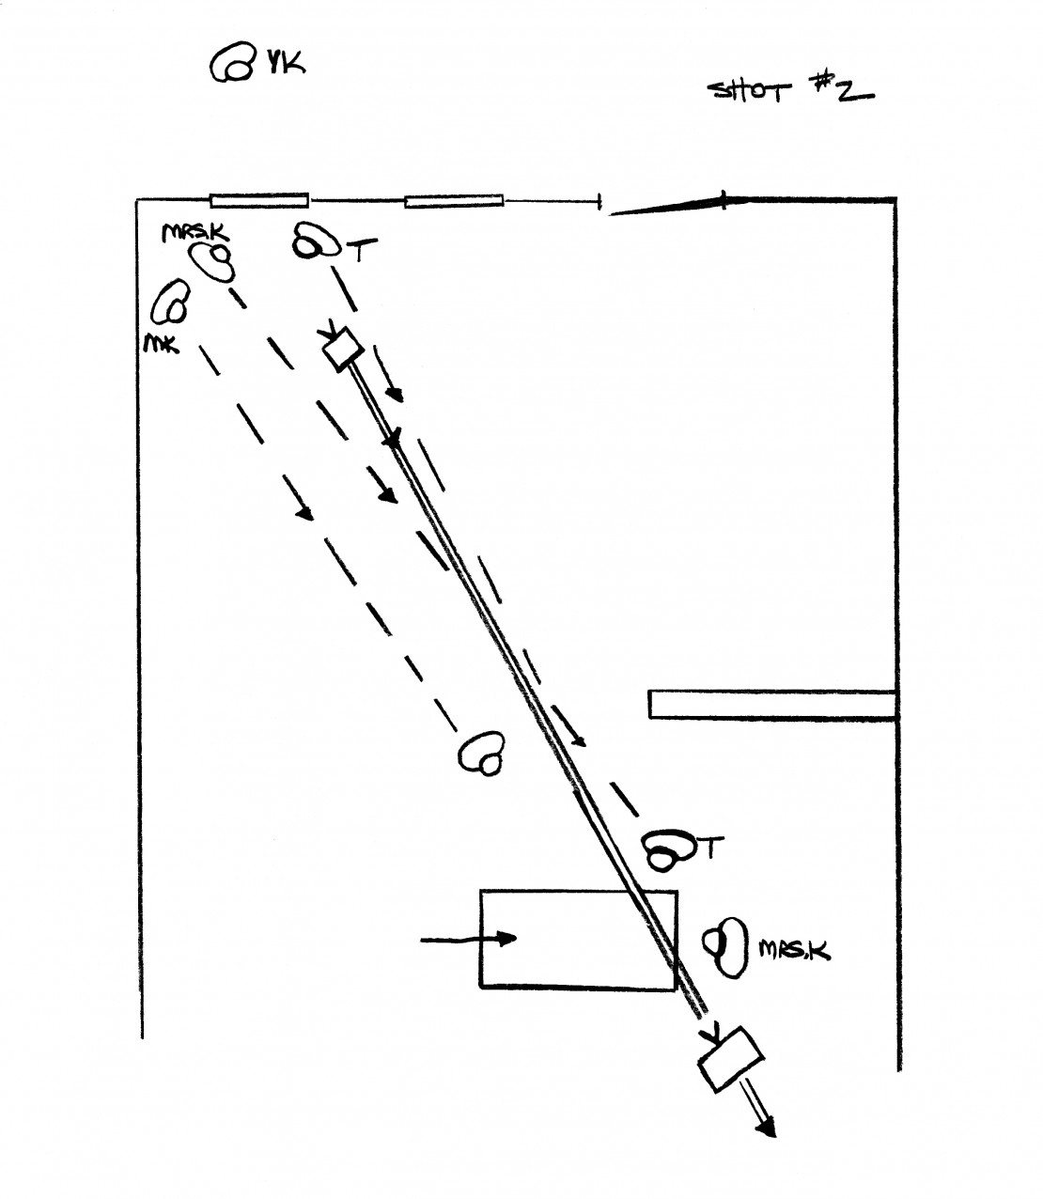

Slide 39
Shot List

Slide 40
Shot List

Slide 41
Spiderman (2002)

